Slide 1
Refraction

Slide 2
Refraction occurs when light travels from one medium into another. This causes the light rays to change direction.
The amount of refraction which occurs depends on the differences in electrical properties in the two media. The electrical properties determine the velocity of a light wave in a medium. This means that when refraction occurs, the speed and direction of the wave change.

Slide 3
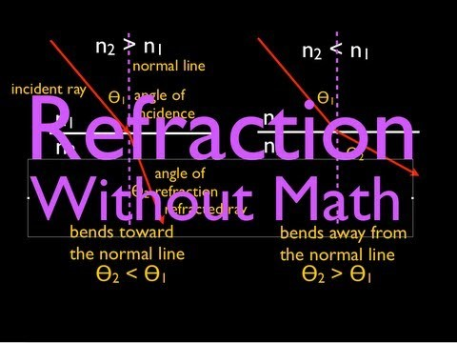

Slide 4
When light passes from one medium into another, it's worth knowing what will happen to that light at the interface. Snell's Law is a powerful formula that allows us to predict the degree of refraction that occurs.

Slide 5
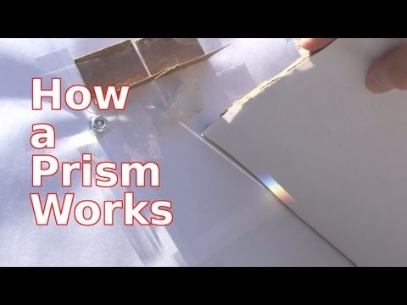

Slide 6
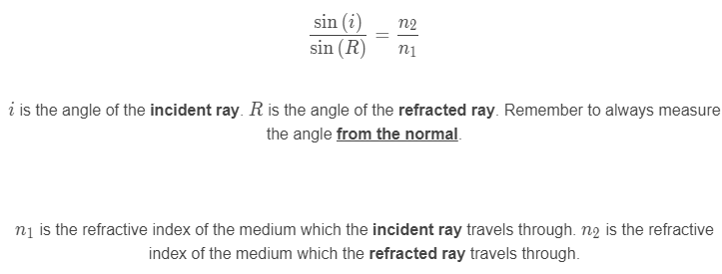
The relative refractive index is used to compare the refractive indices of different media. There only needs to be a very small relative refractive index for refraction of light to occur.
We use the following formula to find how much light bends as it enters a transparent medium:

Slide 7
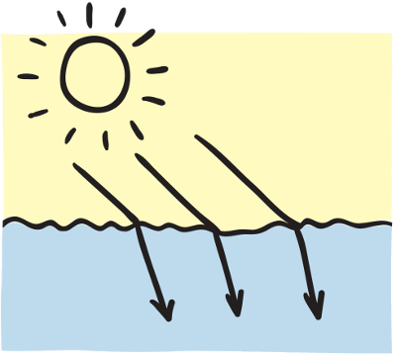
The absolute refractive index is a measure of how much light refracts when it enters the medium from a vacuum.
The absolute refractive index is experimentally determined using the wavelength associated with a sodium atom.
The absolute refractive index of air is 1.0003 and the absolute refractive index of a vacuum is 1.0000. At this level, you can treat air as having a refractive index of 1.00, which is the same as a vacuum.

